Slide 1

Group 6-2-2
Sports: Activity Performance Tracking
Mahidhar Reddy Dwarampudi
Anirudh Varadarajan
Edward Wong
Sai Prasanna Kumar Vadnala
Zuoan He
Report Document: https://docs.google.com/document/d/1FpfP64P9lnYSjLzwzr3vKUGI2tLQHUizrNEwViXrSzM/

Slide 2
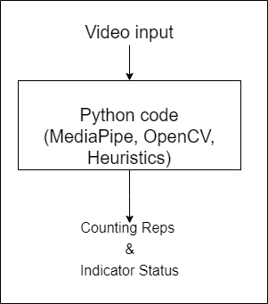
Tight Coupling with Heuristics
Cannot be replicated on different platforms
Major changes for minor additions in heuristics
Hard to replicate, reuse

Slide 3
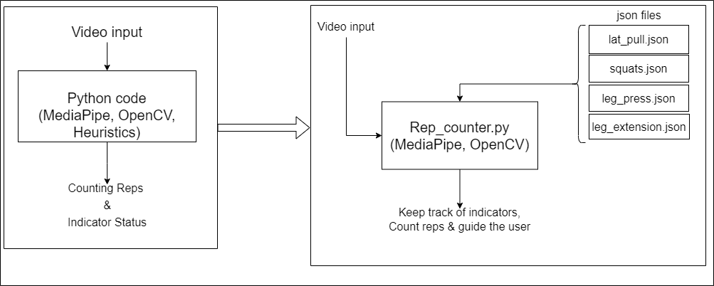

Slide 4
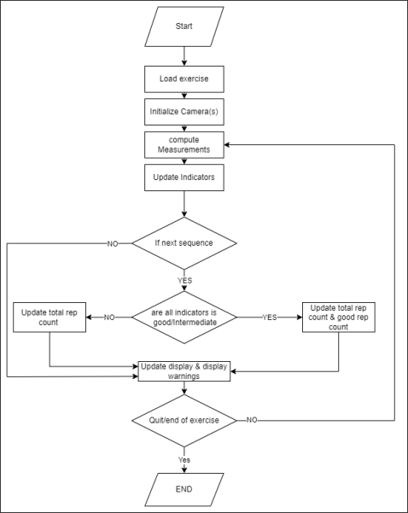
Dynamically adapt to Exercise/cameras
Easily switch between frameworks
Collects data
One size fits all
Generalizes the rep counting

Slide 5
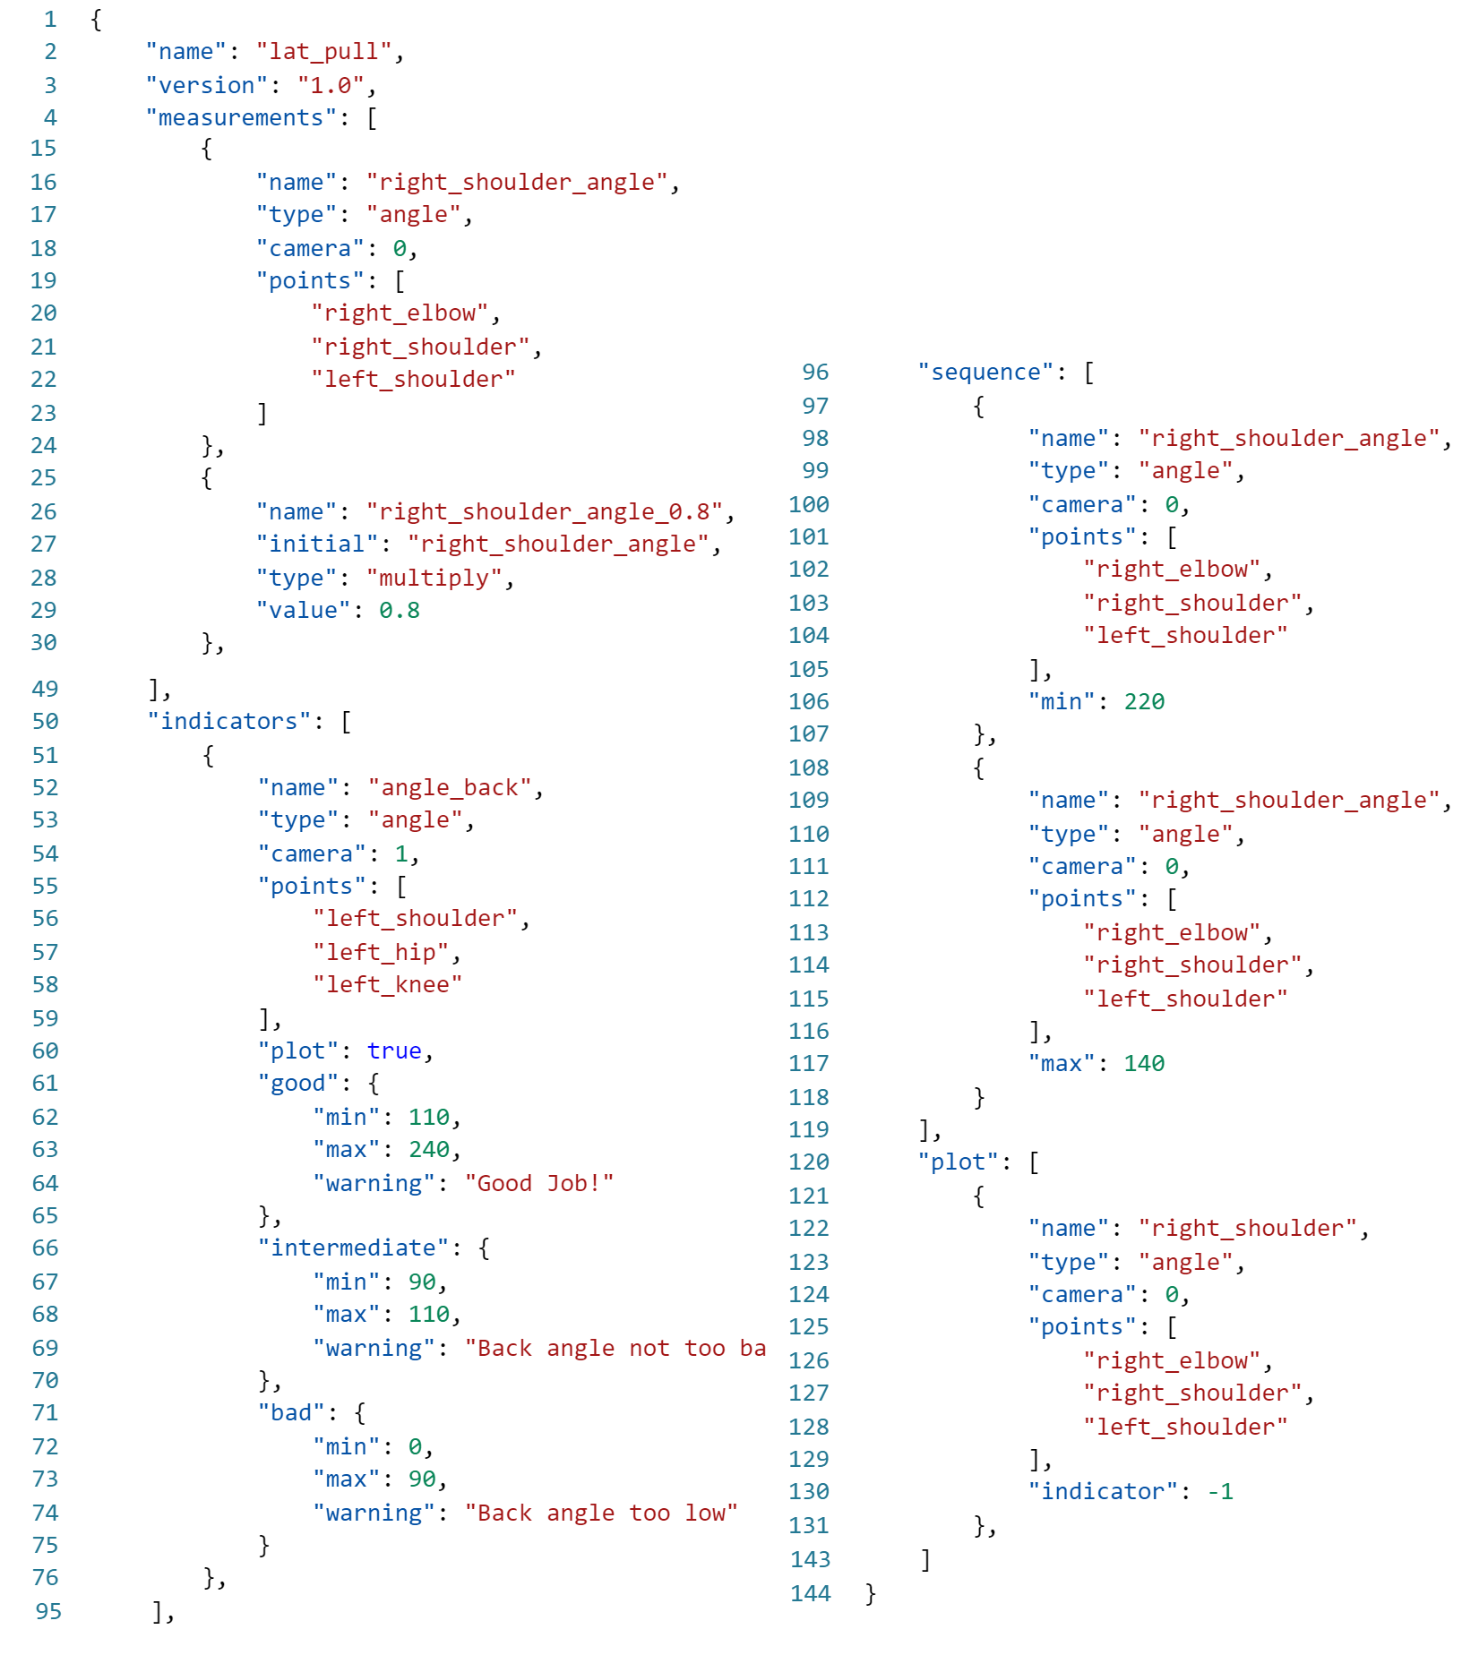
Specify no. of cameras
Measurements and computations
Indicators for tracking posture
Sequences for tracking reps
Additional plotting for visualization
Info for guiding/ warning the user.
Tight coupling with cameras
Platform independent.

Slide 6
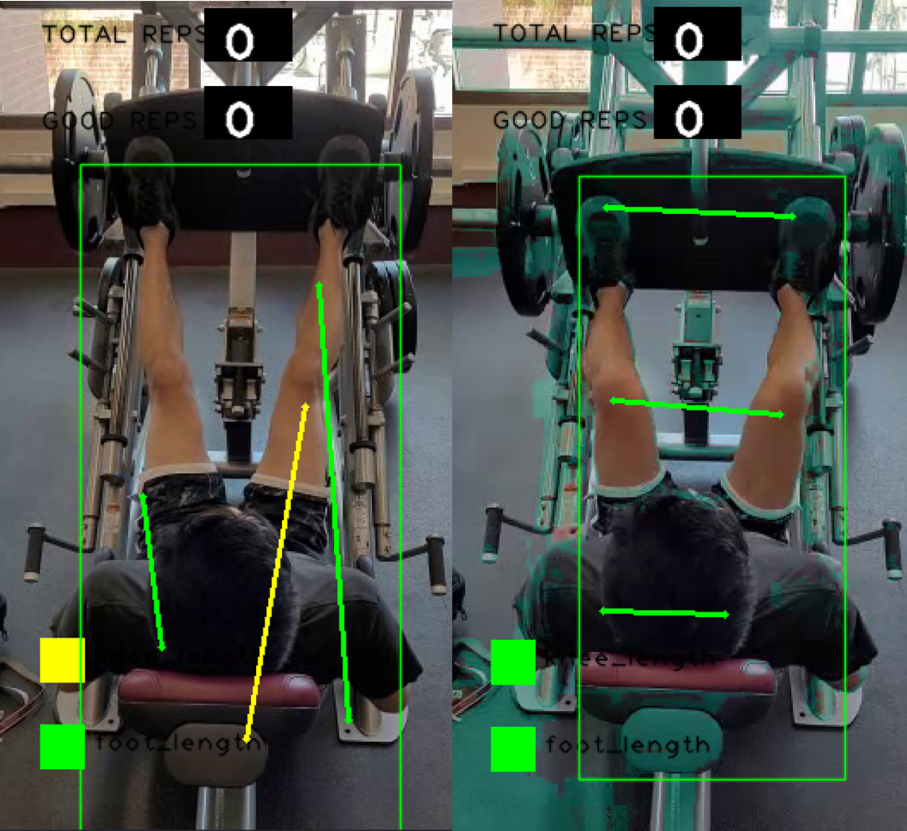
A few drawbacks of MediaPipe
Collecting

Slide 7
Machine Learning Results (Support Vector Machine)
LatPull | Precision | Recall | f1-score | Support
0 | 0.99 | 1.00 | 1.00 | 113
1 | 1.00 | 0.98 | 0.99 | 65
Accuracy | 0.99 |  |  | 178
Macro Avg | 1.00 | 0.99 | 0.99 | 178
WeightedAvg | 0.99 | 0.99 | 0.99 | 178
LegExtension | Precision | Recall | f1-score | Support
0 | 0.94 | 0.83 | 0.88 | 81
1 | 0.82 | 0.94 | 0.88 | 69
Accuracy | 0.88 |  |  | 150
Macro Avg | 0.88 | 0.88 | 0.88 | 150
WeightedAvg | 0.89 | 0.88 | 0.88 | 150
Squat | Precision | Recall | f1-score | Support
0 | 1.00 | 1.00 | 1.00 | 30
1 | 1.00 | 1.00 | 1.00 | 25
Accuracy | 1.00 |  |  | 55
Macro Avg | 1.00 | 1.00 | 1.00 | 55
WeightedAvg | 1.00 | 1.00 | 1.00 | 55
Latpull | Precision | Recall | f1-score | Support
0 | 0.96 | 0.96 | 0.96 | 52
1 | 0.97 | 0.97 | 0.97 | 72
Accuracy | 0.97 |  |  | 124
Macro Avg | 0.97 | 0.97 | 0.97 | 124
WeightedAvg | 0.97 | 0.97 | 0.97 | 124

Slide 8
Problems we faced
Collecting dataset for machine learning model
Synchronizing the videos recorded on different devices (apple/android)
Finding a common pattern for decoupling the heuristics and rep counter

Slide 9
Q & A?
Thank you

Slide 10
Specify no. of cameras
Measurements and computations
Indicators for tracking posture
Sequences for tracking reps
Additional plotting for visualization
Info for guiding/ warning the user.
Preview your main points

Slide 11
Part I: Knowing the ASU color palette

Slide 12
The color palette
R 140 G 29 B 64 #8C1D40
R 255 G 198 B 39 #FFC627
R 92 G 102 B 112 #5C6670
R 255 G 255 B 255
R 0 G 0 B 0
The ASU colors have been programed in the color picker pull-down menu.
Select no more than two or three colors to use per slide to avoid making your slide look like a rainbow…a very ugly ASU rainbow.

Slide 13
Avoid bullet points; instead, aim for one point per slide.

Slide 14
Seems odd; but, trust me—I know what I’m doing here.
“If you absolutely must have two things on one slide (e.g., a point and a quote), remember to place one of those in a space like this that will draw your audience’s attention.” – Aristotle

Slide 15
You might end up with five times as many slides as you would otherwise.
“But that is perfectly OK because your slides are simpler and you will move through them quicker.” – Barack Obama

Slide 16
Over 90 percent of college students agree…

Slide 17
…slides with less text on them actually say more.

Slide 18
Use text color to emphasize an important point.

Slide 19
You may also use a box like this to emphasize an important point.

Slide 20
Be sure to use Arial, it is ASU brand approved and standard on both PCs and Macs.

Slide 21
100
percentage of audience members who are engaged by PowerPoint presentations that are clear and simple

Slide 22
25
percentage of all audience members who would rather write a dissertation than watch a presentation with 5+ bullet points per slide
2
number of times audience members will fall asleep during a PowerPoint presentation that has 5+ bullet points per slide

Slide 23
Part III: Slides that use images

Slide 24

For the most dramatic effect, use no more than one image per slide.

Slide 25

Use large, high-quality images (images that do not become blurry, fuzzy or pixelated when enlarged on a PowerPoint slide).

Slide 26
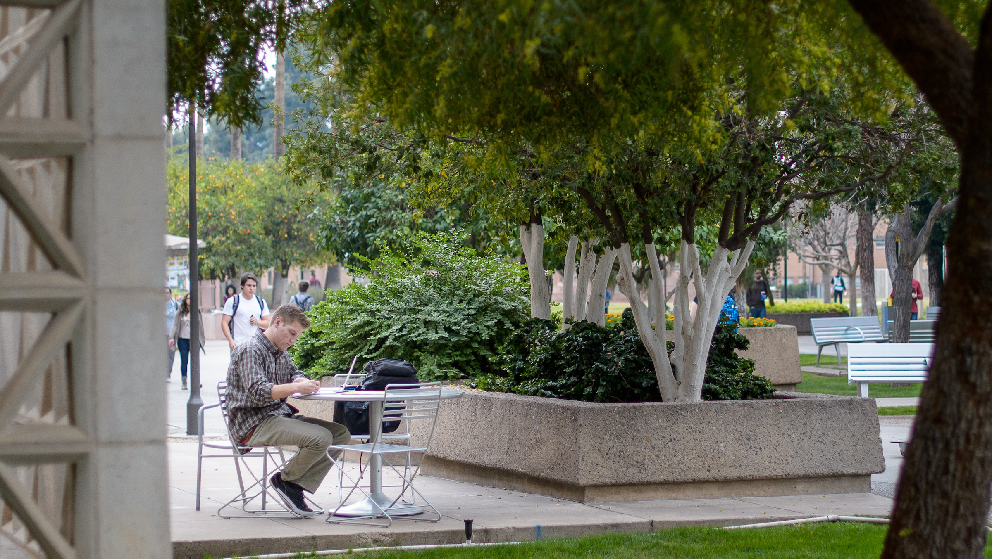
To resize an image, always use the resizing tool on an image’s corner (versus its side); this prevents the image from having a “stretched” appearance.

Slide 27

You may download ASU images for your unit’s print and electronic needs from asu.photoshelter.com. Please email andy.delisle@asu.edu to request access.

Slide 28
Part IV: Slides that use charts

Slide 29
Sometimes you will need to represent ideas in the form of a chart or graph.

Slide 30
For the greatest impact, use the simplest possible representation; for example…

Slide 31
Use shapes and ASU colors
^{94%}
^{78%}
Rated experience good or enjoyable
^{Will return}

Slide 32
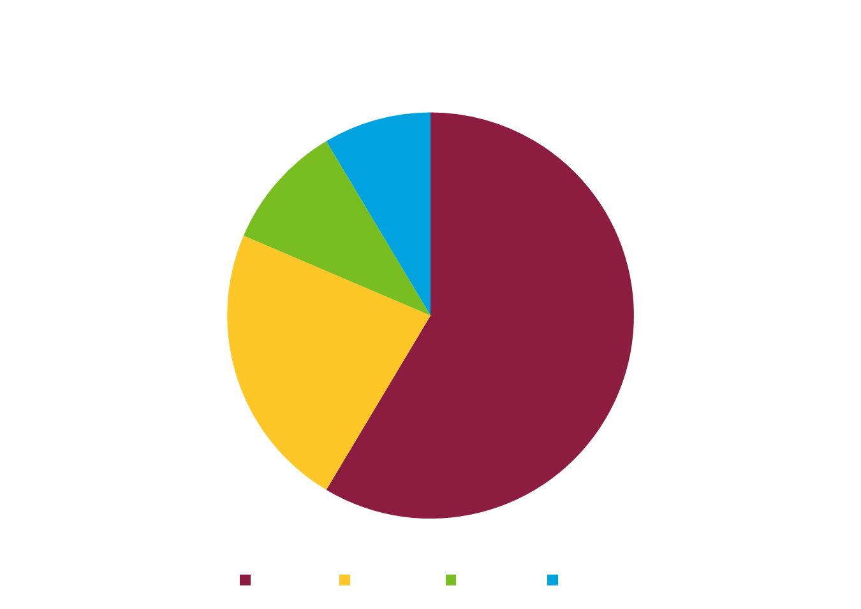

Slide 33
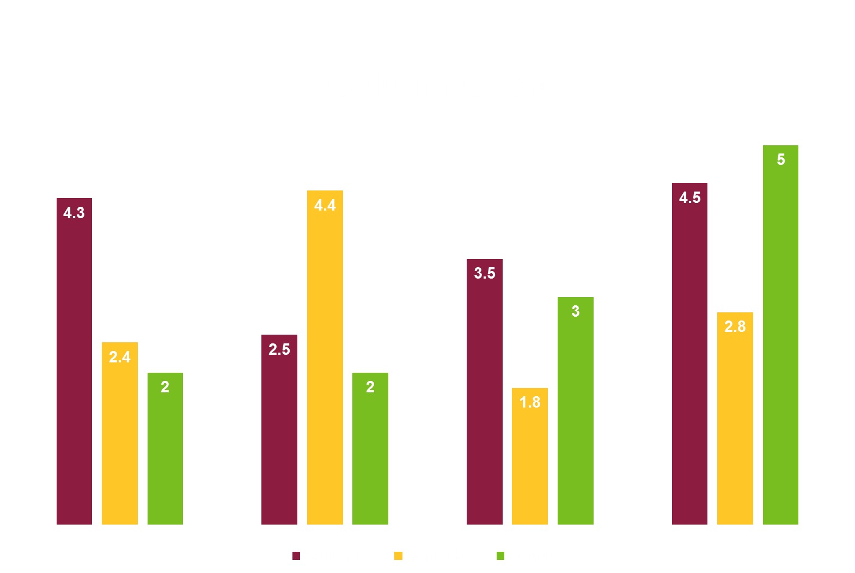

Slide 35
solutions-oriented
entrepreneurial
impact
decisive
access
a New American University
visionary
excellence
bold
create
imaginative
re-envision

Slide 36
Colors
Data
Images
Charts
Restate your main points

